Slide 1
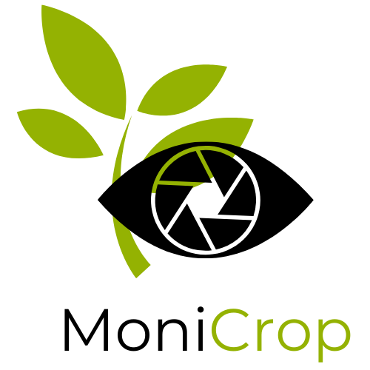

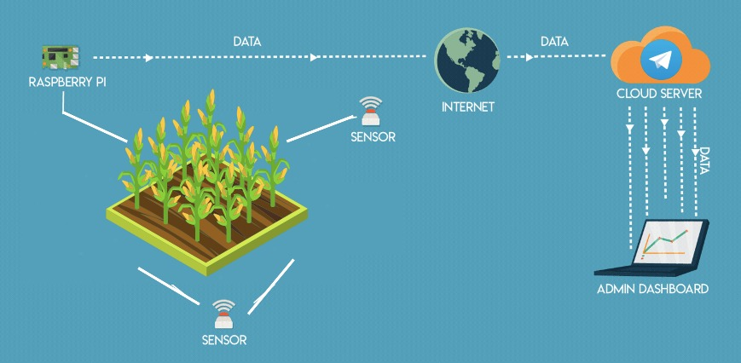





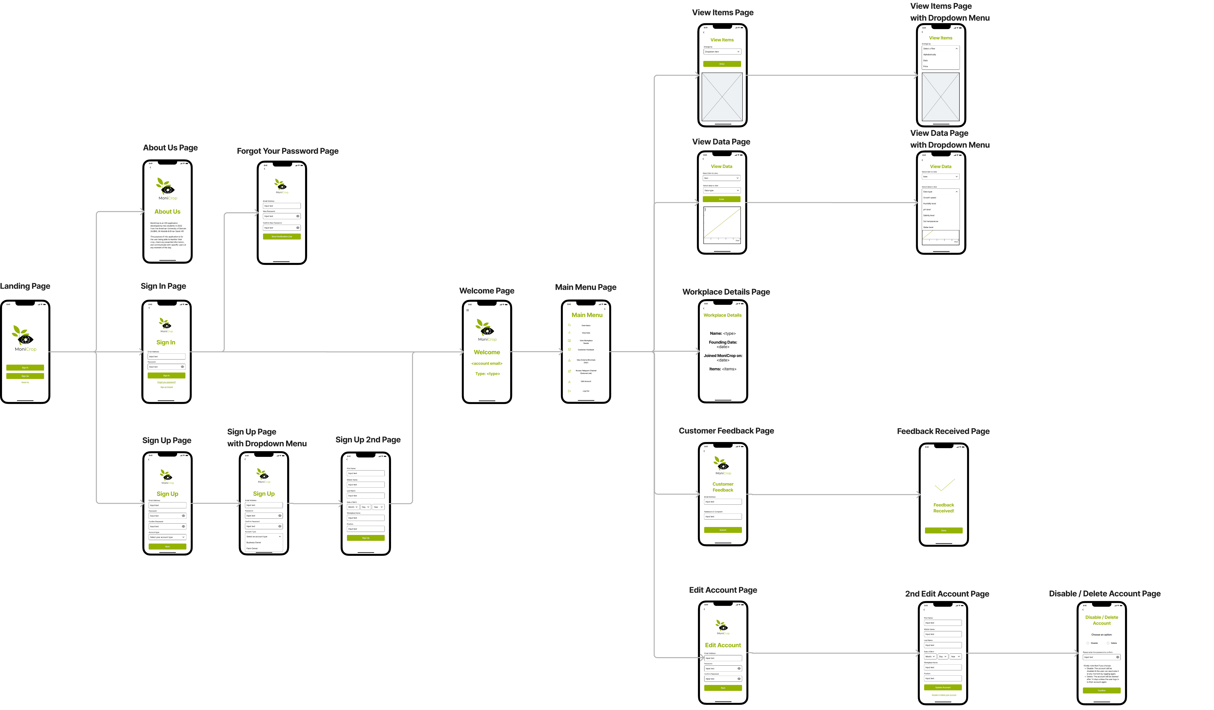


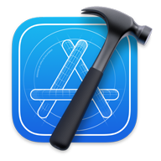

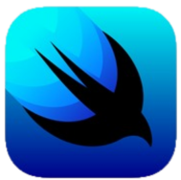

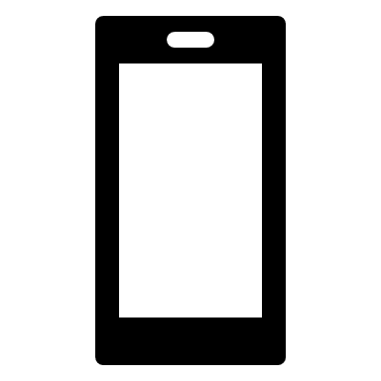

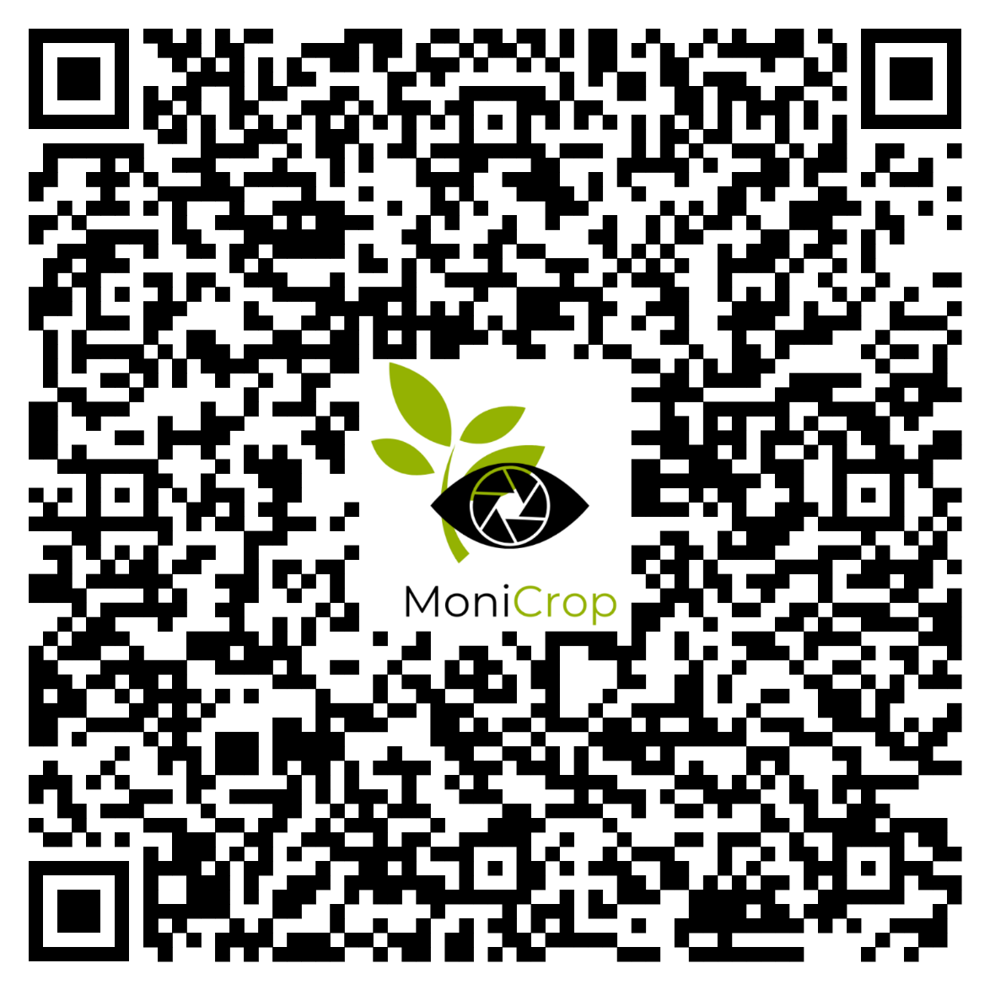
MoniCrop: Development of an iOS Application
for a Smart Crop Monitoring System
Ali Abdulla (A00786) and Eman Sarah Afi (A00051)
COSC 348: Mobile Programming 1
INTRODUCTION AND MOTIVATION
REQUIREMENTS:
FUTURE IMPROVEMENTS
MoniCrop is a supplementary iOS application to be used with a Smart Crop Monitoring System. The system records information about the farm and crops such as the soil’s temperature, salinity, pH levels, and so on. That data can then be viewed on an iOS device using this application.
Agriculture sectors have been affected by a problem where international clients search for agriculture products in other countries that would fit their market needs. Still, they end up receiving low-quality products that barely correspond to the market's needs because the product they are searching for is either overpriced or suspiciously cheap. Thus, developing this system, and a simple mobile application to complement it, we can make it easier for clients to trace whether the products correspond to their market needs before receiving them from the buyer.
Sign Up Processes
Login Processes
Category Options
Information about the Items
Statistics of Crop Development
Customer Feedback
Contact Information
Application Summary
Telegram Channel: Customer Feedback
Telegram Channel: Crop Statistics
To include other features such as a notification system whenever a certain item/data has received an update, the ability to change between various themes, including a dark mode, and the ability to export data to a CSV file. Furthermore, we can let users output data from multiple items to compare them, such as looking at the differences between the pH levels of apples and mangoes.
DESIGN
The project was divided into two parts. The first involved the design section of the project where we used Figma to create wireframes and then a prototype. In total, we made 16 views (excluding the duplicate ones that show the drop-down menu functionality) presented below. The views were designed in a way that has visual elements and icons common on iOS devices. The prototype can also be viewed using the QR code displayed or on the computer from the presenters.
TECHNOLOGY USED
ROADMAP
CONCLUSION
Our team created an iOS application with several views with visual elements such as buttons, a chart, a hamburger menu, radio buttons, pickers (the iOS equivalent of drop-down menus), text fields (including secure ones for passwords), and more. We now have knowledge of the Swift Programming Language and the usage of SwiftUI tools.
Figma – Online tool for developing wireframes and prototypes
macOS - Apple’s Operating System on Mac devices
Swift – Apple’s main programming language
SwiftUI – Apple’s User Interface Toolkit to be used when developing views and visual elements
XCode – Apple’s Integrated Development Environment
Other – APIs, HTML, PHP, Pressure Sensors, Python, and Raspberry Pi
PROTOTYPE

